Slide 1
Important Questions
What is Computer, why it is important?
What is Internet, What is www?
Difference between ram and rom?
Difference between https and https?
What is CPU?
What is Octa-core and quad-core?
What is multitasking and multiuser and multithreading multiprocessing?

Slide 2
Introduction To Computer
A computer is an electronic device that is capable of receiving data (input), processing it as per given instructions (program), and then producing output. It can store data and perform various tasks very quickly and accurately.
Computer word is derived from the Latin word "computare", which means "to calculate".
Characteristics of a Computer:
Speed – Computers can perform millions of instructions per second.
Accuracy – High accuracy with minimum errors.
Automation – Can work automatically once given instructions.
Storage – Can store large amounts of data permanently.
Versatility – Can perform different types of tasks.
Diligence – Unlike humans, computers do not get tired or bored.

Slide 3
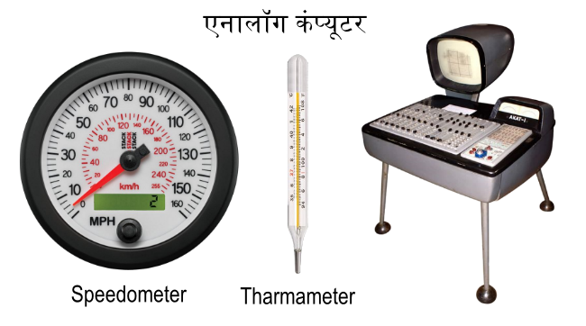
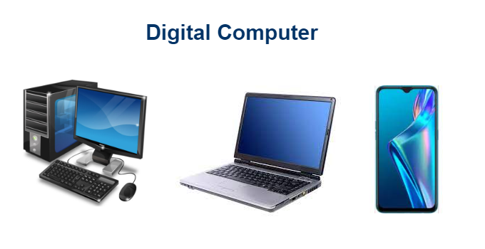
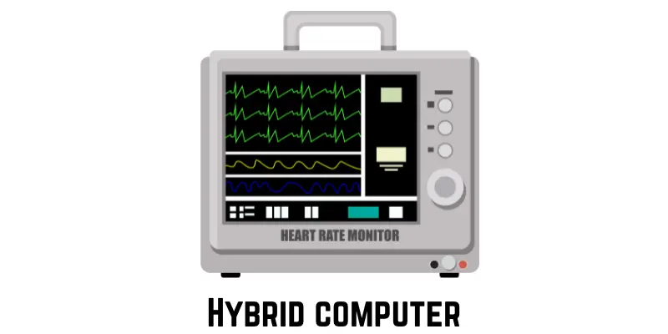
Types Of Computer
a) Analog Computer:
Works on continuous data (not digital).
Used in scientific and engineering applications.
Example: Speedometer, thermometer.
b) Digital Computer:
Works on discrete data (0 and 1 – binary).
Most common type of computer used today.
Example: Laptop, mobile phone.
c) Hybrid Computer:
Combination of analog and digital computer.
Used in hospitals (e.g., ECG machines), scientific applications

Slide 4
Types Of Digital Computer
a) Microcomputer (Personal Computer – PC):
Smallest and most commonly used.
Designed for individual use.
Example: Desktop, Laptop.
b) Mini Computer:
Mid-sized computer.
Supports multiple users at the same time.
Used in small and medium organizations.
c) Mainframe Computer:
Large and powerful systems.
Can support hundreds or thousands of users simultaneously.
Used in banks, railways, government departments.
d) Supercomputer:
Most powerful and fastest computer.
Used in scientific research, weather forecasting, space research.
Example: PARAM, Fugaku.

Slide 5
What are IT Gadgets?
IT (Information Technology) gadgets are smart electronic devices that use computing technology to help users perform various digital tasks more easily, efficiently, and in a mobile or user-friendly way.
These gadgets use internet, wireless technology, sensors, cloud computing, AI, etc., to enhance usability and features.

Slide 6
List of Latest IT Gadgets and Their Applications:
Smartphones:
Mini computers with calling, texting, browsing, gaming, GPS, camera, etc.
Applications:
Social media, online banking, learning apps, video calls, mobile payments (UPI, Paytm), etc.
Tablets and iPads:
Portable touchscreen devices.
Applications:
Reading, attending online classes, entertainment, sketching, note-making, browsing.
Smartwatches:
Wearable device that connects with smartphone.
Applications:
Track health (heart rate, steps), receive calls/messages, GPS tracking, fitness monitoring.

Slide 7
Laptops and Notebooks:
Portable version of desktop computers.
Applications:
Office work, online learning, programming, browsing, designing, business tasks.
Voice Assistants (e.g., Alexa, Google Assistant, Siri):
Use AI to understand voice commands and perform tasks.
Applications:
Home automation, asking questions, setting reminders, playing music, controlling smart devices.
Smart TVs:
Television with internet connectivity and apps.
Applications:
Watch YouTube, Netflix, online content, connect phones, use voice control.

Slide 8
Drones:
Remotely operated flying machines with cameras.
Applications:
Aerial photography, surveillance, agriculture, military, delivery services.
VR (Virtual Reality) Headsets:
Devices that give immersive 3D experience.
Applications:
Gaming, training simulations, education, architecture, entertainment.
Smart Speakers:
Wireless speaker with virtual assistant.
Applications:
Voice-controlled music, news updates, controlling smart home devices.

Slide 9
Smart Home Devices (IoT Devices):
Internet-connected devices used at home.
Examples: Smart bulbs, smart locks, smart ACs, smart refrigerators.
Applications:
Home automation, remote control via mobile apps.

Slide 10
Applications of Computers and IT Gadgets in Daily Life:
Area | Applications
Education | Online classes, e-books, virtual labs
Healthcare | Patient monitoring, telemedicine, digital reports
Banking | Online banking, ATMs, digital payments
Business | Data processing, emails, video meetings
Entertainment | Music, movies, online games, social media
Travel and Transport | Online bookings, GPS navigation, smart cards
Government Services | Online forms, public portals, Aadhaar verification

Slide 11
Evolution of Computers (History)
The evolution of computers refers to the development of computing machines from simple calculating tools to the highly intelligent systems we use today.
The journey of computers began with basic mechanical devices and moved forward through various stages of technological advancement.

Slide 12
Early Calculating Devices
Device | Inventor | Year | Description
Abacus | Chinese Civilization | ~3000 BC | First manual calculator using beads.
Napier’s Bones | John Napier | 1617 | Used for multiplication and division.
Pascaline | Blaise Pascal | 1642 | First mechanical calculator.
Analytical Engine | Charles Babbage | 1837 | Considered the first concept of a modern computer.

Slide 13
Generations of Computers
The development of computer technology is divided into five generations, each marked by significant advancements in hardware and software.
1st Generation Computers (1940–1956)
Technology Used: Vacuum Tubes
Programming Language: Machine language (binary code – 0s and 1s)
Size: Very large (occupied entire rooms)
Speed: Very slow
Examples: ENIAC, EDVAC, UNIVAC
Drawbacks:
Produced a lot of heat
Required air conditioning
Frequently failed

Slide 14
2nd Generation Computers (1956–1963)
Technology Used: Transistors (replaced vacuum tubes)
Programming Language: Assembly language
Size: Smaller and more reliable
Speed: Faster than 1st generation
Examples: IBM 1401, IBM 7094
Advantages:
Less heat
Less power consumption
Better performance

Slide 15
3rd Generation Computers (1964–1971)
Technology Used: Integrated Circuits (IC)
Programming Language: High-level languages (like FORTRAN, COBOL)
Size: More compact
Speed: Much faster
Examples: IBM System/360
Advantages:
Lower cost
Better storage and processing
Supported multitasking

Slide 16
4th Generation Computers (1971–Present)
Technology Used: Microprocessors (first was Intel 4004)
Programming Language: All modern programming languages
Size: Very small – personal computers
Speed: Very high processing speed
Examples: Desktop computers, laptops, tablets
Advantages:
Affordable for personal use
Highly reliable
Use of GUI (Graphical User Interface), mouse, keyboard

Slide 17
5th Generation Computers (Present & Beyond)
Technology Used: Artificial Intelligence (AI), robotics, cloud computing, quantum computing
Programming Concepts: Machine learning, Natural Language Processing (NLP)
Features:
Self-learning systems
Voice and image recognition
Real-time processing
Examples: AI assistants (Alexa, Siri), smart robots, quantum computers
Advantages:
Intelligent decision making
Automation of complex tasks
IoT (Internet of Things) integration

Slide 18
What is CPU?
The CPU (Central Processing Unit) is known as the “Brain of the Computer”. It is responsible for performing all calculations, processing data, and controlling all the operations of the computer system.
It processes the instructions given by the user and executes them.
Major Functions of CPU:
Processing Data: It processes the data according to the given instructions.
Controlling Operations: It controls the working of all parts of the computer.
Performing Calculations: It performs arithmetic and logical operations.
Fetching & Executing Instructions: It fetches instructions from memory and executes them step-by-step.

Slide 19
Main Components of CPU
The CPU is mainly divided into three parts:
ALU (Arithmetic and Logic Unit)
Performs all arithmetic operations like addition, subtraction, multiplication, division.
Performs logical operations like comparison (greater than, less than, equal to).
It is the calculating unit of the CPU.
CU (Control Unit)
Manages and controls all activities inside the computer.
It directs the flow of data between memory, ALU, and input/output devices.
Does not process data itself but controls how other parts work.
Registers
Small high-speed memory inside the CPU.
Temporarily stores data, instructions, or results during processing.
Faster than RAM and helps in quick access to frequently used data.

Slide 20
How CPU Works (In Simple Steps):
Fetch – The control unit fetches instructions from memory.
Decode – The instruction is decoded to understand the operation.
Execute – ALU executes the instruction.
Store – Result is stored in memory or sent to output.
Important Points:
CPU is installed on the motherboard.
The performance of a computer depends largely on the speed and power of the CPU.
CPU speed is measured in GHz (Gigahertz).
Modern CPUs are multi-core, meaning multiple processing units in one chip (like Dual-core, Quad-core).

Slide 21
What are Input Devices?
Input Devices are hardware components that are used to enter data and instructions into the computer system for processing.
These devices allow the user to interact with the computer by providing raw data, which is later processed by the CPU.
Functions of Input Devices:
Accept data from the user.
Convert human-readable data into machine-readable form (binary).
Send data and instructions to the CPU for processing.
Commonly Used Input Devices:
Keyboard
Most commonly used input device.
Used to type letters, numbers, and symbols.
Contains keys like alphabets (A–Z), numbers (0–9), function keys (F1–F12), special keys (Enter, Shift, Ctrl).

Slide 22
Mouse
A pointing device used to control the pointer on the screen.
Used for clicking, selecting, dragging, and scrolling.
Contains left button, right button, and scroll wheel.
Scanner
Used to convert physical documents or images into digital form.
Scanned files can be edited, saved, or shared easily.
Types: Flatbed Scanner, Hand-held Scanner.
Microphone
Used to input audio or voice into the computer.
Used in voice recording, video calls, speech recognition.
Webcam
Captures live video or images.
Commonly used for video conferencing, online classes, streaming.

Slide 23
Joystick
Used to play video games or control simulation software.
Works by tilting in different directions.
Touchscreen
A display screen that also acts as an input device.
Users can give input by touching icons or text directly on the screen.
Commonly used in smartphones, tablets, ATMs.
Trackball
Similar to a mouse, but with a rotating ball on the top.
The ball is rolled using fingers to move the cursor.
Often used in laptops or special control systems.
Light Pen
A pen-like device used to draw directly on a screen or select objects.
Mostly used in design, drawing, or CAD applications.

Slide 24
Barcode Reader
Used to scan barcodes on products.
Commonly used in shopping malls, warehouses, and libraries.
Biometric Devices
Used to input personal identification data like fingerprints, iris scan, or facial recognition.
Used for security and authentication purposes (e.g., Aadhaar authentication).

Slide 25
Output Devices
Output Devices are hardware components used to display, print, or present the results of data processing performed by the computer.
They convert machine-readable data (binary) into human-readable form such as text, images, sound, or printed output.
Functions of Output Devices:
Receive processed data from the CPU.
Convert it into meaningful output.
Present the result to the user in different forms (visual, audio, printed).
Types of Output Devices:
Monitor (Visual Display Unit – VDU)
Displays visual output from the computer (text, graphics, videos).
Comes in different types:
CRT (Cathode Ray Tube) – Old, bulky.
LCD (Liquid Crystal Display) – Slim, energy-efficient.
LED (Light Emitting Diode) – Brighter, modern displays.
Acts as a primary output device.

Slide 26
Printer
Used to get hard copy (printed form) of documents or images.
Converts digital data into printed text or graphics on paper.
Type | Description
Inkjet Printer | Sprays ink, good for home use.
Laser Printer | Uses laser technology, fast and clear.
Dot Matrix Printer | Uses pins and ink ribbon, used in bill printing.

Slide 27
Speakers
Output device for sound/audio.
Plays music, system sounds, videos, etc.
Often used in multimedia systems, games, and video calls.
Headphones/Earphones
Personal audio output devices.
Allow only the user to hear sound privately.
Useful for online classes, meetings, and listening to music
Projector
Projects the output (from a monitor or computer) onto a large screen or wall.
Used in classrooms, seminars, conferences.
Helps in group presentations and public viewing.

Slide 28
Plotter
Special type of printer used to print large-sized drawings or graphics like maps, engineering designs, architectural plans.
Used by engineers, architects, and designers.
Braille Display (for Visually Impaired)
Converts digital text into Braille script using raised dots.
Helps visually impaired users to read digital content.

Slide 29
What is Memory?
Computer memory is a component that stores data, instructions, and information either temporarily or permanently. It plays a vital role in the overall performance of a computer.
Types of Memory
1. Primary Memory (Main Memory)
This is the main working memory of the computer. It is directly accessible by the CPU, faster but limited in capacity.
Types of Primary Memory:
a) RAM (Random Access Memory)
Volatile memory (data is lost when power is off)
Temporarily holds data and programs currently in use
Allows both read and write operations
More RAM = better multitasking
Example: When you open an app or a browser tab, it runs in RAM.
b) ROM (Read-Only Memory)
Non-volatile memory (data remains even after shutdown)
Stores firmware or system instructions like the BIOS
Data is mostly written during manufacturing
Cannot be modified easily
It helps in booting up the system.

Slide 30
Secondary Memory (Storage Devices)
This memory is used to store data permanently. It is not directly accessed by the CPU — data is first transferred to RAM.
Examples of Secondary Memory
Storage Device | Description
HDD (Hard Disk) | Magnetic disk, large capacity
SSD | Faster and more reliable than HDD
CD/DVD | Optical media, used for data and videos
USB Drive | Portable and commonly used
Memory Card | Used in smartphones, cameras, etc.
External HDD | Used for backups and large file storage

Slide 31
Difference Between Primary and Secondary Memory
Feature | Primary Memory (RAM/ROM) | Secondary Memory (HDD/SSD)
Speed | Very fast | Slower
Volatility | RAM is volatile | Non-volatile
Storage Capacity | Limited | High
Cost | More expensive per GB | Cheaper per GB
Access | Direct by CPU | Not direct, accessed via software

Slide 32
Cache Memory
A high-speed memory located between CPU and RAM
Stores frequently accessed data and instructions
Much faster than RAM but very small in size
Speeds up processing time
Registers
Smallest and fastest memory inside the CPU
Holds data/instructions that the CPU is currently processing
Very limited in size

Slide 33
Memory Units (from smallest to largest)
Unit | Equivalent
1 Bit | Smallest unit (0 or 1)
1 Byte | 8 Bits
1 KB | 1024 Bytes
1 MB | 1024 KB
1 GB | 1024 MB
1 TB | 1024 GB
1 PB | 1024 TB
Volatile vs Non-Volatile Memory
Type | Description | Examples
Volatile Memory | Loses data when power is turned off | RAM, Cache
Non-Volatile | Keeps data without power | ROM, HDD, SSD

Slide 34
Types of RAM (Random Access Memory)
There are mainly two types of RAM:
1.1 DRAM (Dynamic RAM)
Stores each bit of data in a capacitor.
Needs to be refreshed continuously to retain data.
Cheaper and slower than SRAM.
Used in most personal computers.
1.2 SRAM (Static RAM)
Stores data using flip-flops (transistors).
Does not need refreshing, retains data as long as power is on.
Faster and more expensive than DRAM.
Used in cache memory (inside CPU).
Optional: Other Variants
SDRAM (Synchronous DRAM) – synchronized with CPU clock.
DDR RAM (Double Data Rate) – transmits data twice per clock cycle.
DDR2, DDR3, DDR4, DDR5 are faster versions.

Slide 35
What is ROM?
ROM (Read Only Memory) is a non-volatile memory used to store firmware or system boot instructions, i.e., data that does not change and is needed to start the computer.
Internal Function of ROM:
Stores permanent data that is written at manufacturing time.
Helps computer perform POST (Power-On Self-Test) during startup.
Loads BIOS which initializes hardware before handing control to OS.

Slide 36
Main Components of ROM:
Component | Function
Decoder | Selects memory cell to be read
Memory Cell Array | Holds data in 0s and 1s
Address Lines | Carry location information
Data Lines | Carry stored data to output
Control Lines | Control reading operations

Slide 37
Working of ROM:
CPU sends address of the required instruction.
ROM decoder activates that memory location.
Stored data is read and sent to CPU via data lines.
CPU uses that data for system startup (booting).
What is a Hard Disk?
A Hard Disk Drive (HDD) is a non-volatile secondary storage device that stores OS, files, applications, videos, etc., permanently.

Slide 38
Parts of a Hard Disk:
Part | Description
Platter | Round magnetic disks where data is stored
Spindle | Holds and spins the platters at high speed
Read/Write Head | Reads or writes data on the platters
Actuator Arm | Moves the read/write head across platters
Actuator | Controls the movement of actuator arm
Disk Controller | Interface between the hard disk and computer
Cache (Buffer) | Temporary memory inside HDD to speed up access

Slide 39
Working of a Hard Disk:
When you open a file, the CPU sends a request to the hard disk.
The disk controller receives the request and sends it to the actuator.
The actuator arm moves the read/write head to the correct location on the spinning platter.
The read head reads the magnetic signals and sends data back to CPU via controller.
While saving files, write head converts data into magnetic signals and stores it on the platter.
The platters spin at high speed (e.g., 5400 or 7200 RPM), allowing fast access to data.

